Slide 1
Intermediate Macroeconomics Axelle Ferriere, Sciences Po, Spring 2026
Chapter 7
Labor market, wages, and unemployment

Slide 2
Lecture objectives and reading
Learn about empirical facts
Labor market data
Introduce stylized labor market models
A simple Walrasian model of the labor market
A bathtub model of unemployment
Modern theories of labor markets
Tools
Walrasian equilibrium
Beveridge curve

Slide 3
Outline
Labor market evidence from the U.S.
Measuring unemployment
Business cycles vs. long term trends
Household maximization problem
Walrasian model of the labor market
Modern models of the labor market

Slide 4
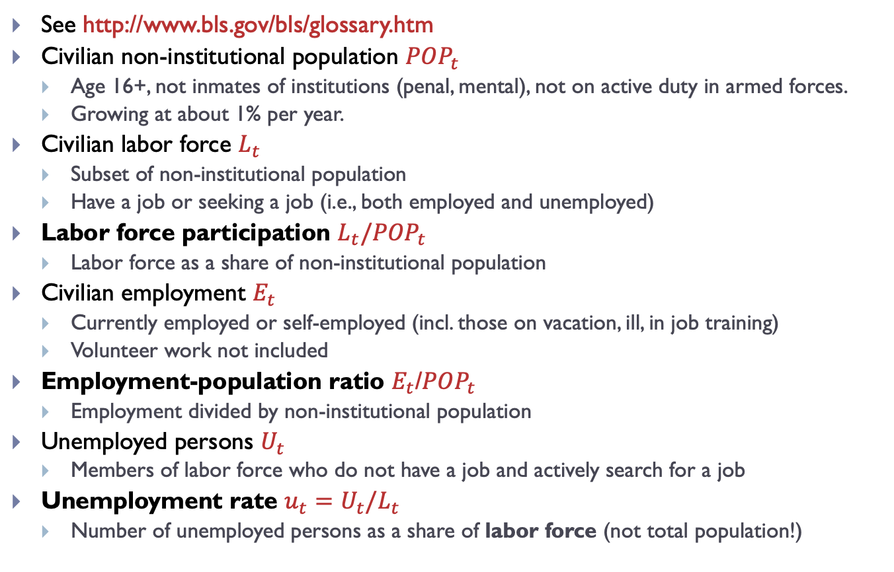
Some definitions
See http://www.bls.gov/bls/glossary.htm
Civilian non-institutional population ${POP}_{t}$
Age 16+, not inmates of institutions (penal, mental), not on active duty in armed forces.
Growing at about 1% per year.
Civilian labor force $L_{t}$
Subset of non-institutional population
Have a job or seeking a job (i.e., both employed and unemployed)
Labor force participation $L_{t}/{POP}_{t}$
Labor force as a share of non-institutional population
Civilian employment $E_{t}$
Currently employed or self-employed (incl. those on vacation, ill, in job training)
Volunteer work not included
Employment-population ratio $E_{t}$/${POP}_{t}$
Employment divided by non-institutional population
Unemployed persons $U_{t}$
Members of labor force who do not have a job and actively search for a job
Unemployment rate $u_{t}=U_{t}/L_{t}$
Number of unemployed persons as a share of labor force (not total population!)

Slide 5
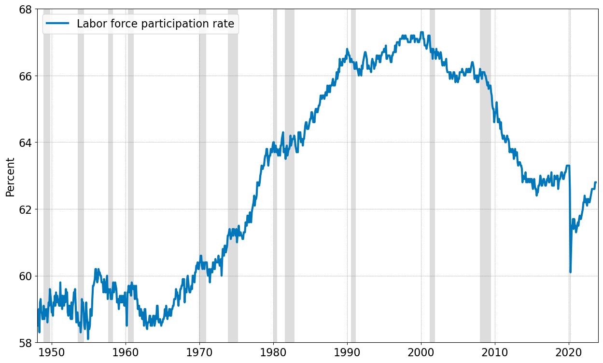

Labor force participation rate $≈62\%$
Labor force participation is procyclical (increases in expansions, decreases in recessions).
Source: FRED (series CIVPART – monthly data), Bureau of Labor Statistics

Slide 6
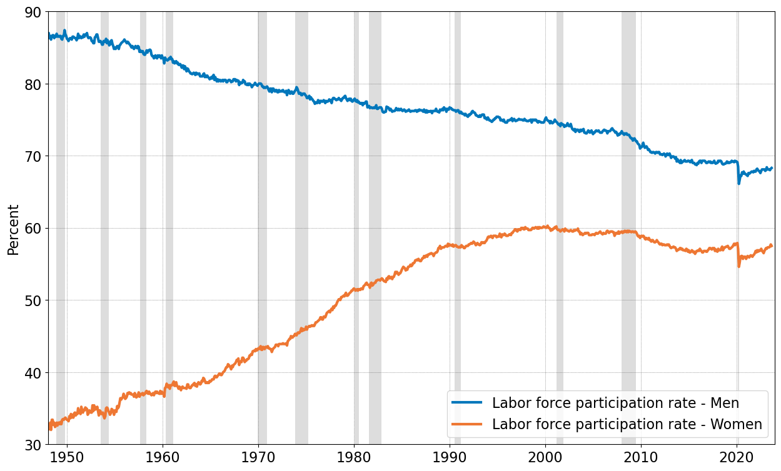
Labor force participation by gender
Increase in female labor force participation
(Why?)
Labor force participation of both groups decreases
(Why?)
Source: FRED (series LNS11300001 and LNS11300002 – monthly data), Bureau of Labor Statistics

Slide 7
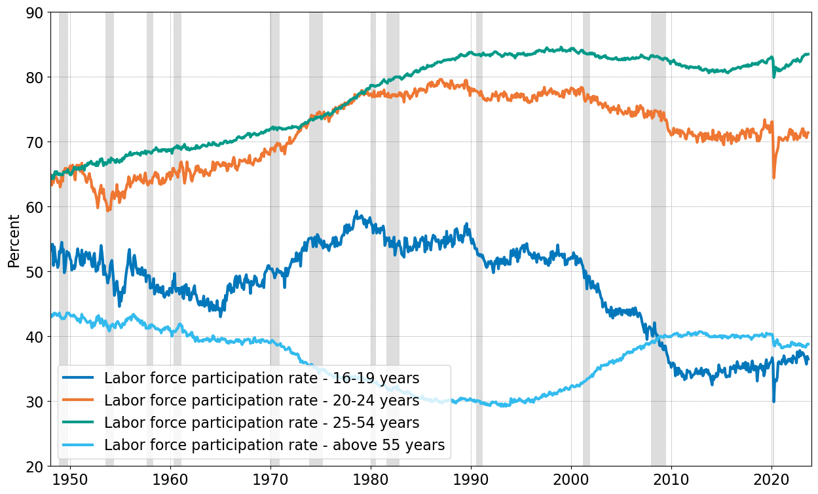
Labor force participation by age group
more schooling
working longer
Composition effects: As population ages, more people move to older age groups with lower labor force participation
Source: FRED (series LNS11300012, LNS11300036, LNS11300060, LNS11324230 – monthly data)

Slide 8
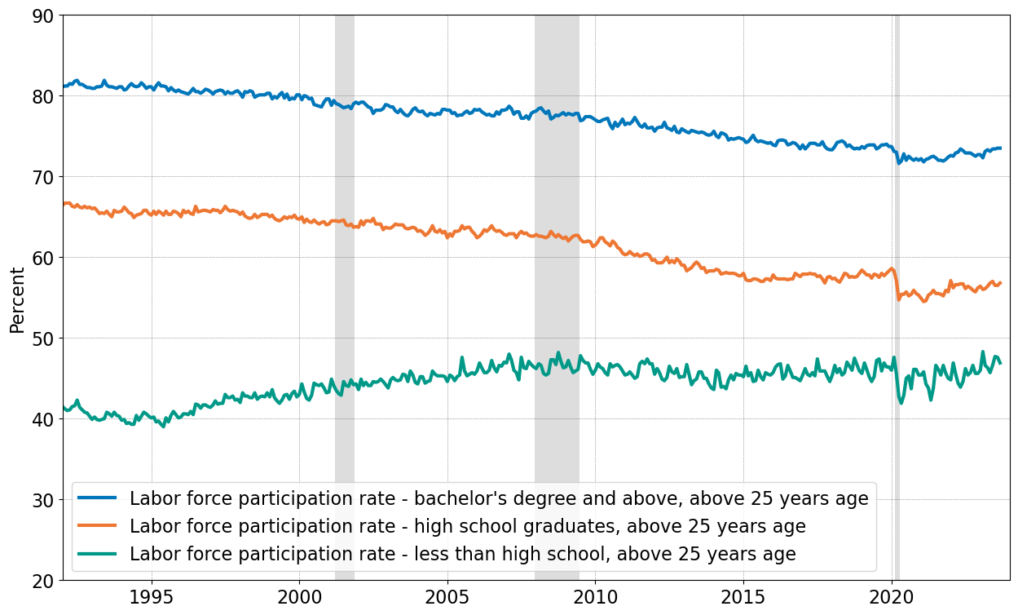
Labor force participation by education
Source: FRED (series LNS11327662, LNS11327660, LNS11327659 – monthly data)

Slide 9
Labor force participation summary
Differences in participation rates by gender
Slow, persistent declines for men
Rapid increase and then stabilization for women
Age composition
Young and old cohorts are less attached to labor market
Increases in participation rates for old cohorts
Differences in participation rates by education
More educated people have much higher participation rates
Two main shifts since 1950s
Increase in participation rate between 1960s and 1990s
Driven primarily by increased participation of women (changes in social norms, technology for managing fertility, reduced discrimination)
Decline in 2000s
Partly due to aging population (composition effects)
Young people join labor force later (schooling)

Slide 10
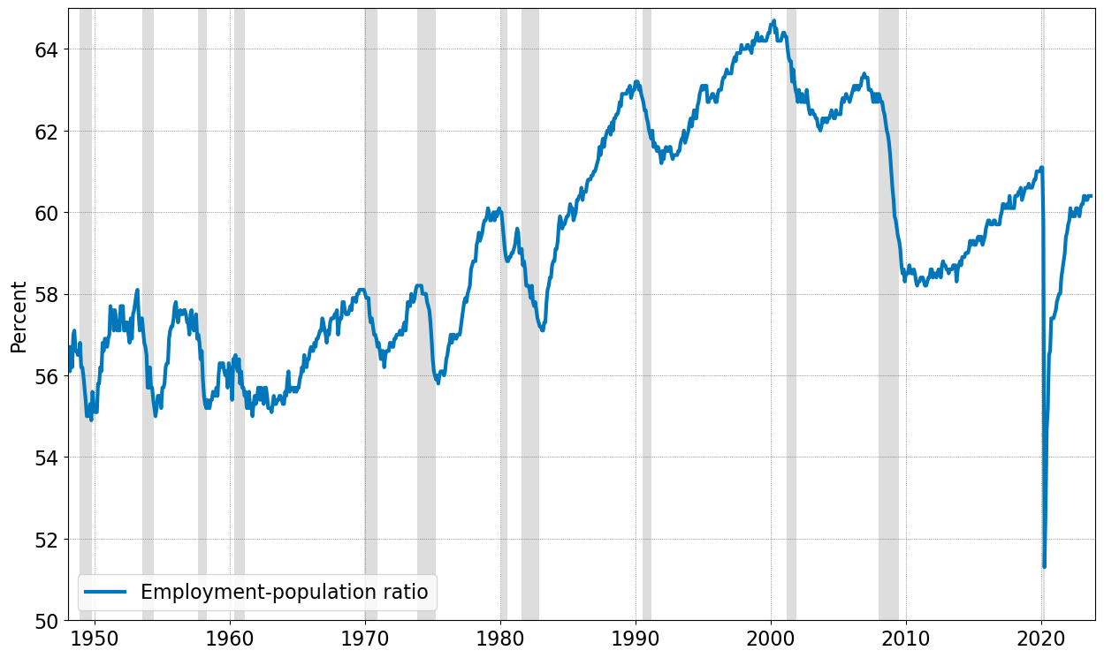

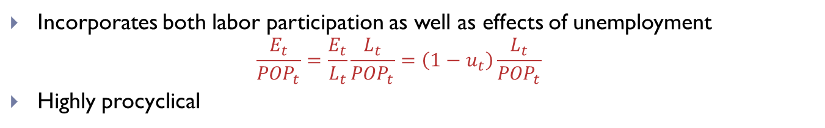
Employment-population ratio rate $≈60\%$
Increase in labor force participation
Reversal of both trends
Decrease in unemployment
Incorporates both labor participation as well as effects of unemployment
$$\frac{E_{t}}{{POP}_{t}}=\frac{E_{t}}{L_{t}}\frac{L_{t}}{{POP}_{t}}=\left(1−u_{t}\right)\frac{L_{t}}{{POP}_{t}}$$
Highly procyclical
Source: FRED (series EMRATIO – monthly data)

Slide 11
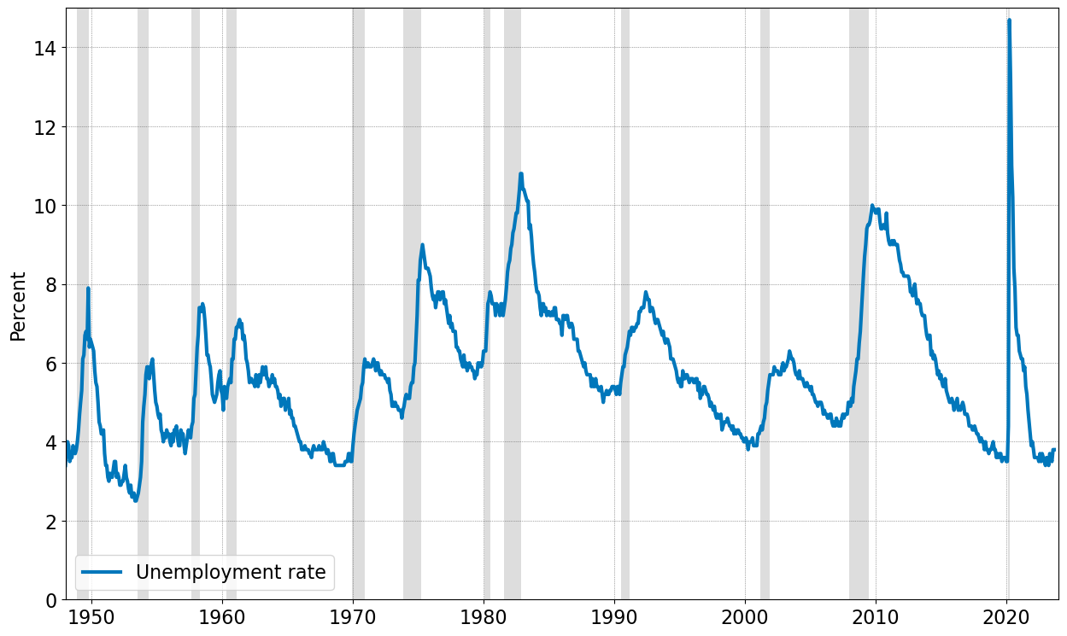

Unemployment rate $≈5\%$
Coronavirus epidemic
Economic difficulties during 1970s
The Great Recession
The Great Moderation
Unemployment rate is countercyclical (low in expansions, high in recessions).
Source: FRED (series UNRATE – monthly data)

Slide 12
Different types of unemployment
Actual unemployment = natural + cyclical unemployment
Natural rate of unemployment
“rate of unemployment arising from all sources except fluctuations in aggregate demand”
Unemployment rate that would prevail if economy was neither in expansion nor in recession
Cannot be measured directly, need a model to determine it.
Natural rate of unemployment = frictional + structural
Frictional unemployment = resulting from the fact that search for a new job takes time
Structural unemployment = caused by labor market institutions that slow down matching – incl. hiring and firing costs, unemployment benefits and minimum wage
Cyclical unemployment
Caused by short-run business cycle fluctuations

Slide 13
Unemployment & labor market conditions
Is the unemployment rate a good measure of labor market conditions?
When economic conditions worsen significantly, some unemployed may get discouraged and stop searching
Not searching ⇒ not in labor force ⇒ not counted as unemployed!
Discouragement actually lowers the unemployment rate.
Some workers may have jobs but work less than they would like to.
Alternatives?
Other measures of unemployment?

Slide 14
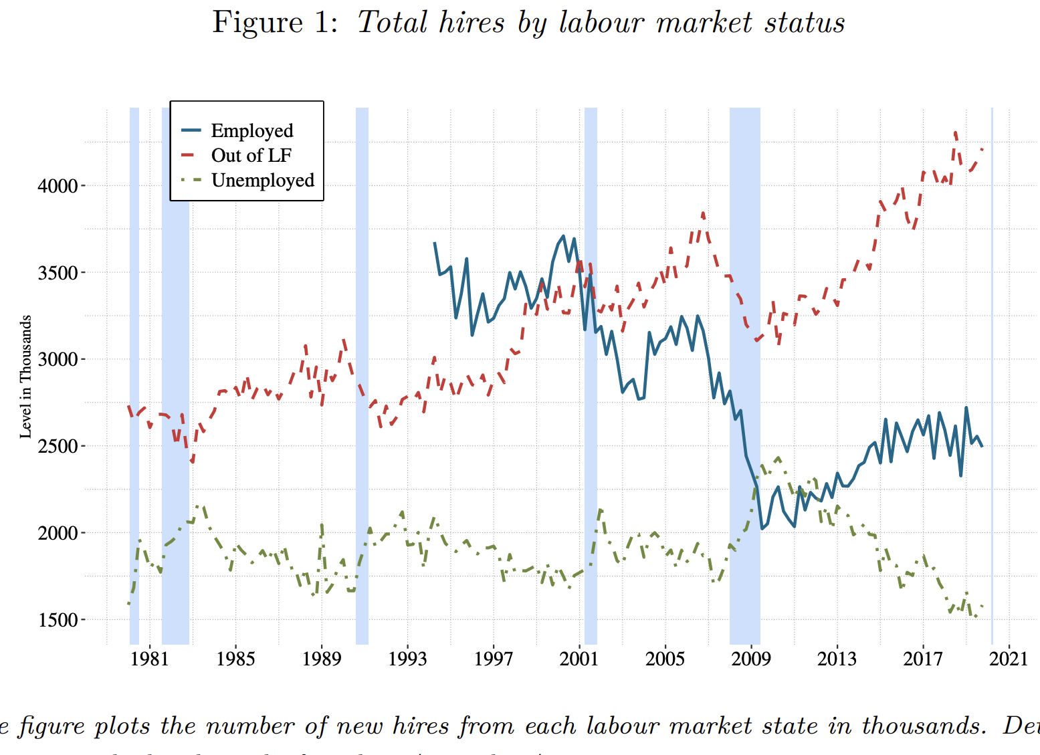
Unemployment vs. Out of the labor force?
“Measuring the Total Number of US Job Seekers”, C. Braun, The Economic Journal (2024).

Slide 15
Unemployment and the cycle
Unemployment increases in recessions
Okun’s law: a 1% fall in output increases unemployment by about 50 basis points
Aggregate demand effects on unemployment
Embedded in Federal Reserve Board models
Empirical estimates vary over time and countries…
“Okun’s Law: Fit at 50?”, by L. Ball, D. Leigh, and P. Loungani, Journal of Money, Credit and Banking (2017)
Lower in Europe? Large heterogeneity on period 1980-2013
France, Portugal: -0.3; Spain: -0.8

Slide 16
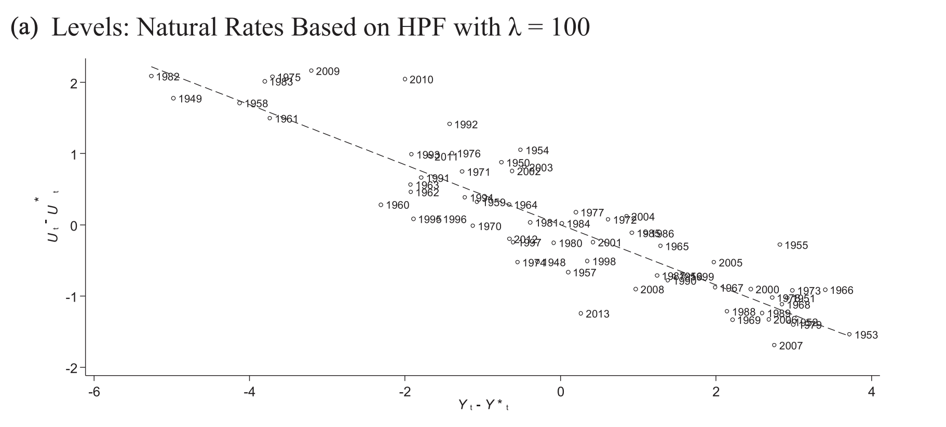
Unemployment and the cycle
Annual data for the United States
“Okun’s Law: Fit at 50?”, by L. Ball, D. Leigh, and P. Loungani, Journal of Money, Credit and Banking (2017)

Slide 17
Unemployment duration in the U.S.
In normal times, unemployment spells are mostly short
Median duration < 10 weeks, average duration ~ 15 weeks
Why is median duration shorter than average?
In recessions, duration lengthens
Hysteresis in the labor market
As workers stay unemployed for a long time, they lose skills
It is even more difficult for them to find a new job
Unemployment declines only very slowly
Notes:
Talk about uninsurable idiosyncratic risk

Slide 18
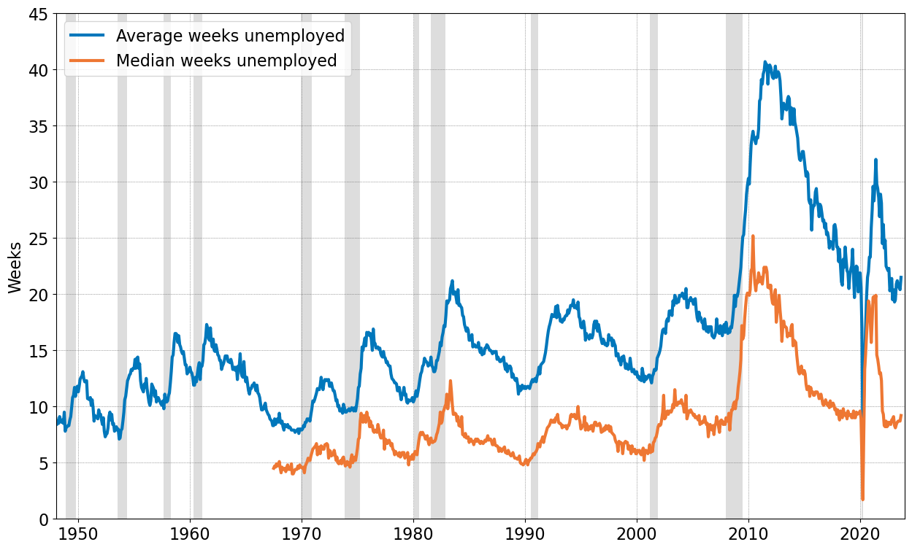
Unemployment duration in the U.S.
Highly countercyclical, slowly trending up, very high during the recent recession.
Source: FRED (series UEMPMEAN, UEMPMED – monthly data)

Slide 19
Outline
Labor market evidence from the U.S.
Household maximization problem
Optimal labor supply choice
Labor and taxation
Walrasian model of the labor market
Modern models of the labor market

Slide 20
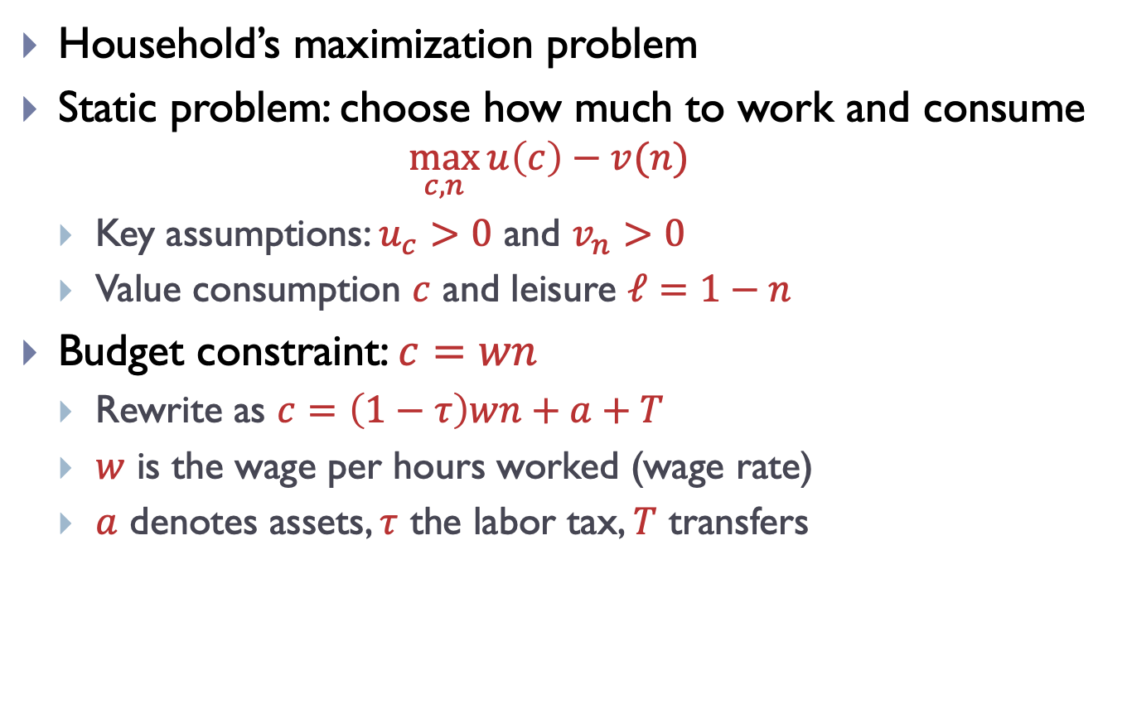
Labor supply in Partial Equilibrium
Household’s maximization problem
Static problem: choose how much to work and consume
$$\max_{c,n}{u\left(c\right)−v(n)}$$
Key assumptions: $u_{c}>0$ and $v_{n}>0$
Value consumption $c$ and leisure $ℓ=1−n$
Budget constraint: $c=wn$
Rewrite as $c=\left(1−τ\right)wn+a+T$
$w$ is the wage per hours worked (wage rate)
$a$ denotes assets, $τ$ the labor tax, $T$ transfers

Slide 21
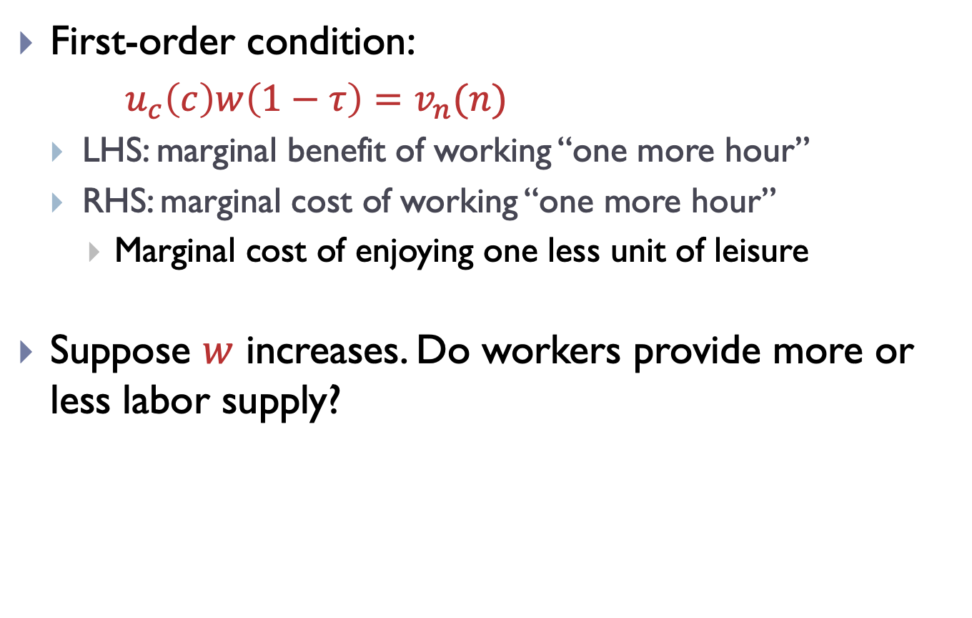
Optimal individual labor supply
First-order condition:
$u_{c}\left(c\right)w\left(1−τ\right)=v_{n}(n)$
LHS: marginal benefit of working “one more hour”
RHS: marginal cost of working “one more hour”
Marginal cost of enjoying one less unit of leisure
Suppose $w$ increases. Do workers provide more or less labor supply?

Slide 22
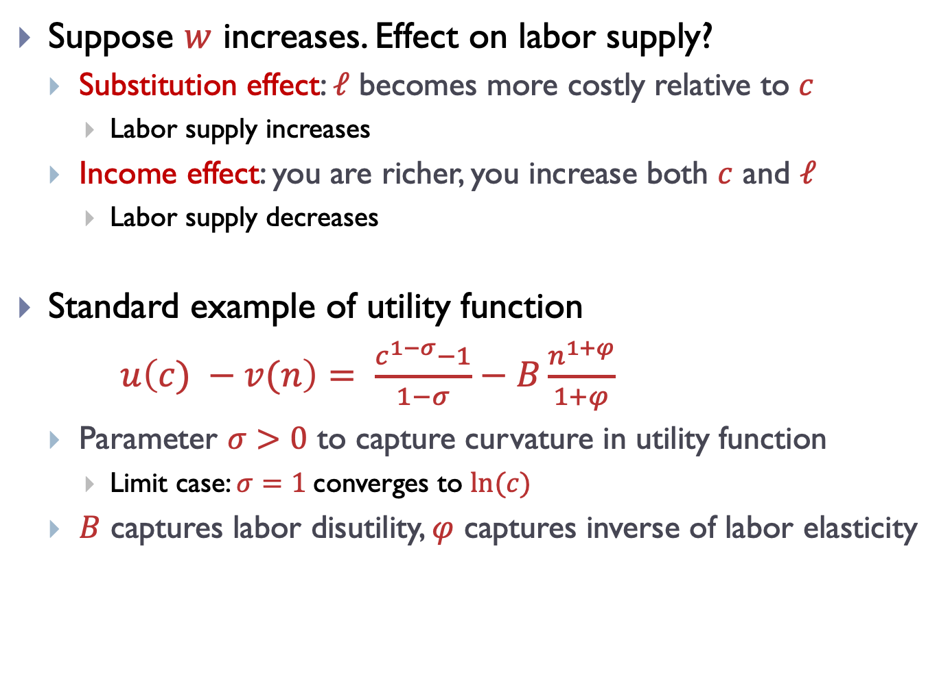
Substitution and income effects
Suppose $w$ increases. Effect on labor supply?
Substitution effect: $ℓ$ becomes more costly relative to $c$
Labor supply increases
Income effect: you are richer, you increase both $c$ and $ℓ$
Labor supply decreases
Standard example of utility function
$u\left(c) −v(n\right)= \frac{c^{1−σ}−1}{1−σ}−B\frac{n^{1+φ}}{1+φ}$
Parameter $σ>0$ to capture curvature in utility function
Limit case: $σ=1$converges to $ln⁡(c)$
$B$ captures labor disutility, $φ$ captures inverse of labor elasticity

Slide 23
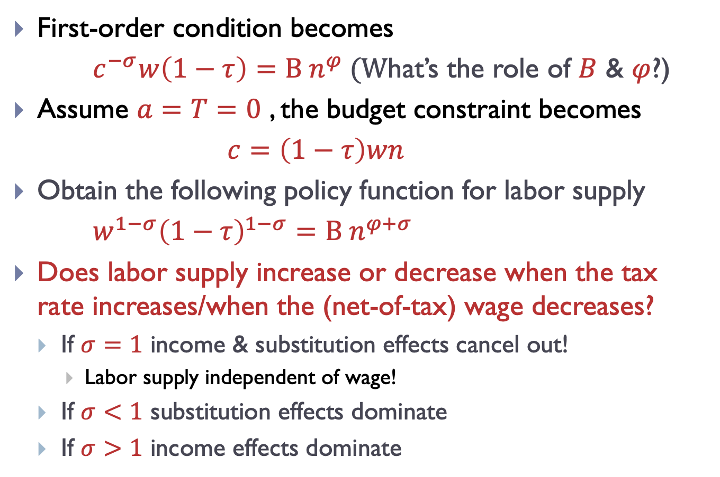
Substitution and income effects
First-order condition becomes
$c^{−σ}w\left(1−τ\right)=B n^{φ} (W$hat’s the role of $B$ & $φ$?)
Assume $a=T=0$ , the budget constraint becomes
$c=\left(1−τ\right)wn$
Obtain the following policy function for labor supply
$w^{1−σ}{\left(1−τ\right)}^{1−σ}=B n^{φ+σ}$
Does labor supply increase or decrease when the tax rate increases/when the (net-of-tax) wage decreases?
If $σ=1$ income & substitution effects cancel out!
Labor supply independent of wage!
If $σ<1$ substitution effects dominate
If $σ>1$ income effects dominate

Slide 24
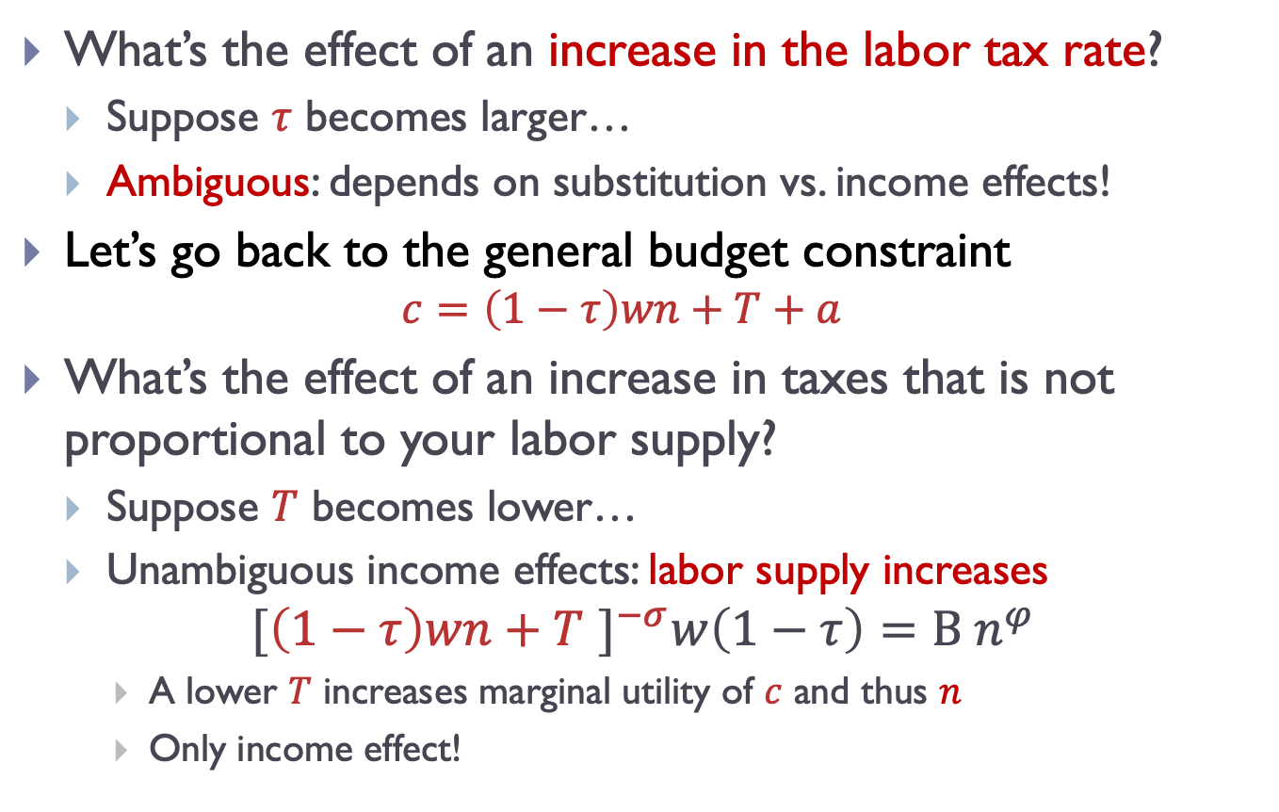
Labor tax and lump-sum tax
What’s the effect of an increase in the labor tax rate?
Suppose $τ$ becomes larger…
Ambiguous: depends on substitution vs. income effects!
Let’s go back to the general budget constraint
$$c=\left(1−τ\right)wn+T+a$$
What’s the effect of an increase in taxes that is not proportional to your labor supply?
Suppose $T$ becomes lower…
Unambiguous income effects: labor supply increases
$${[\left(1−τ\right)wn+T ]}^{−σ}w\left(1−τ\right)=B n^{φ}$$
A lower $T$ increases marginal utility of $c$ and thus $n$
Only income effect!

Slide 25
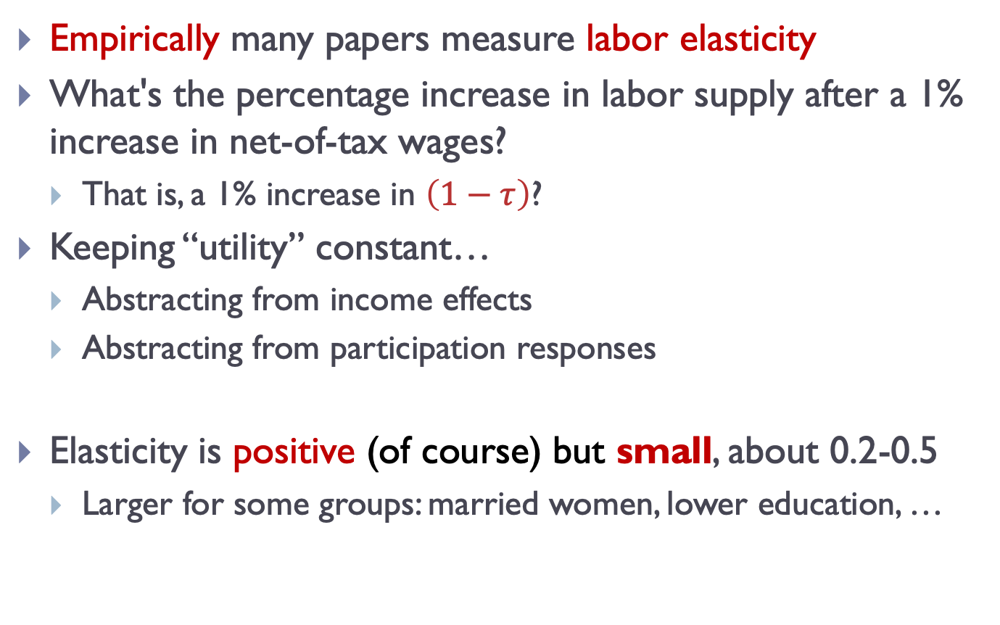
Labor supply and change in labor tax
Empirically many papers measure labor elasticity
What's the percentage increase in labor supply after a 1% increase in net-of-tax wages?
That is, a 1% increase in $\left(1−τ\right)$?
Keeping “utility” constant…
Abstracting from income effects
Abstracting from participation responses
Elasticity is positive (of course) but small, about 0.2-0.5
Larger for some groups: married women, lower education, …

Slide 26
Labor supply & change in lump-sum tax
Change in lump-sum tax or change in wealth
How to measure income effects in the data?
“How Americans respond to idiosyncratic and exogenous changes in household wealth and unearned income”, by M. Golosov, M. Graver, M. Mogstad and D. Novgorodsky, The Quarterly Journal of Economics (2024)
Merge lottery winnings data with earnings data covering the universe of U.S. taxpayers
Idea: lottery win introduces exogenous variation in wealth

Slide 27
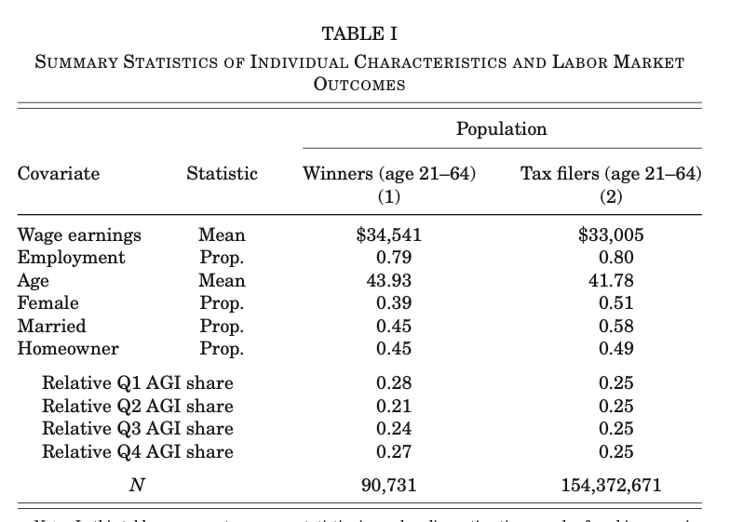
Labor supply and income effects
Concern: are people who play the lottery systematically different from general population?

Slide 28
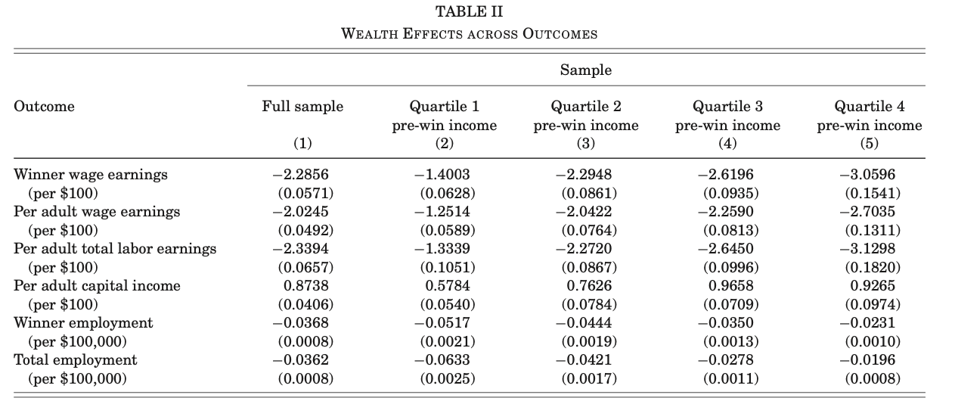
Labor supply and income effects
Study wealth / income effects on household earnings
Average over 5 years, total and by income group
Earnings respond, partly due to the extensive margin

Slide 29
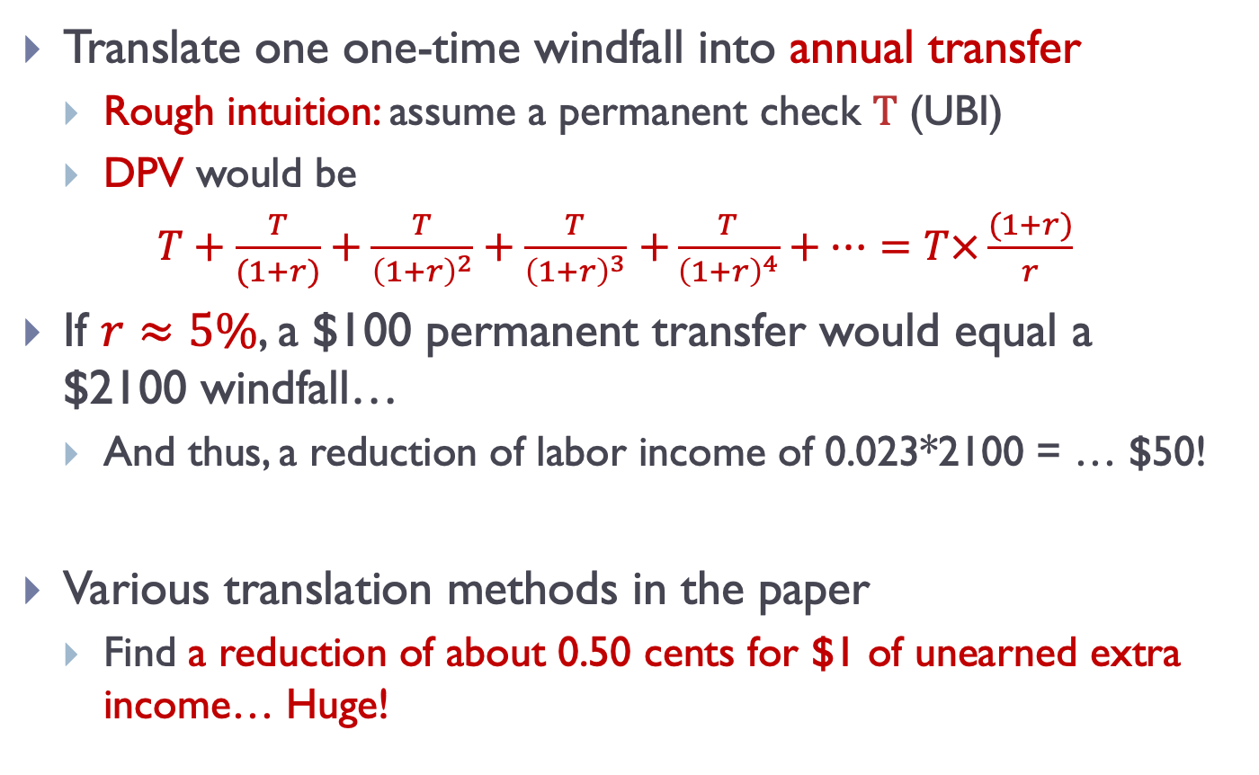
Labor supply and income effects
Translate one one-time windfall into annual transfer
Rough intuition: assume a permanent check $T$ (UBI)
DPV would be
$T+\frac{T}{(1+r)}+\frac{T}{{\left(1+r\right)}^{2}}+\frac{T}{{\left(1+r\right)}^{3}}$ $+\frac{T}{{\left(1+r\right)}^{4}}+…=T×\frac{(1+r)}{r}$
If $r≈5\%$, a $100 permanent transfer would equal a $2100 windfall…
And thus, a reduction of labor income of 0.023*2100 = … $50!
Various translation methods in the paper
Find a reduction of about 0.50 cents for $1 of unearned extra income… Huge!

Slide 30
Outline
Labor market evidence from the U.S.
Household maximization problem
Walrasian model of the labor market
Aggregate labor and supply demand
Taxation & minimum wage
Modern models of the labor market

Slide 31
Aggregate labor supply
Labor supply curve
Represents the willingness of people to work at different wages
An increasing function of wage on aggregate level
At the individual level, income vs. substitution effect
At the aggregate, substitution effect dominates
Labor force participation
Extensive margin: no income effect!

Slide 32
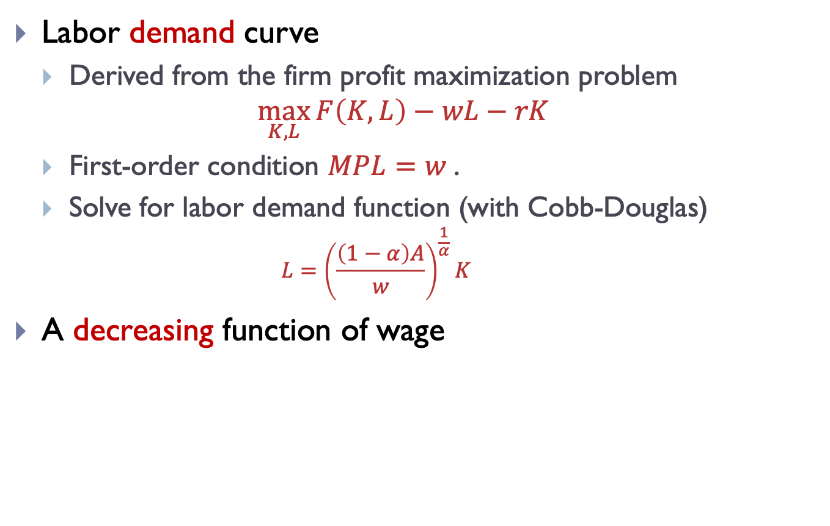
Aggregate labor demand
Labor demand curve
Derived from the firm profit maximization problem
$$\max_{K,L}{F\left(K,L\right)−wL−rK}$$
First-order condition $MPL=w$.
Solve for labor demand function (with Cobb-Douglas)
$$L={\left(\frac{\left(1−α\right)A}{w}\right)}^{\frac{1}{α}}K$$
A decreasing function of wage

Slide 33
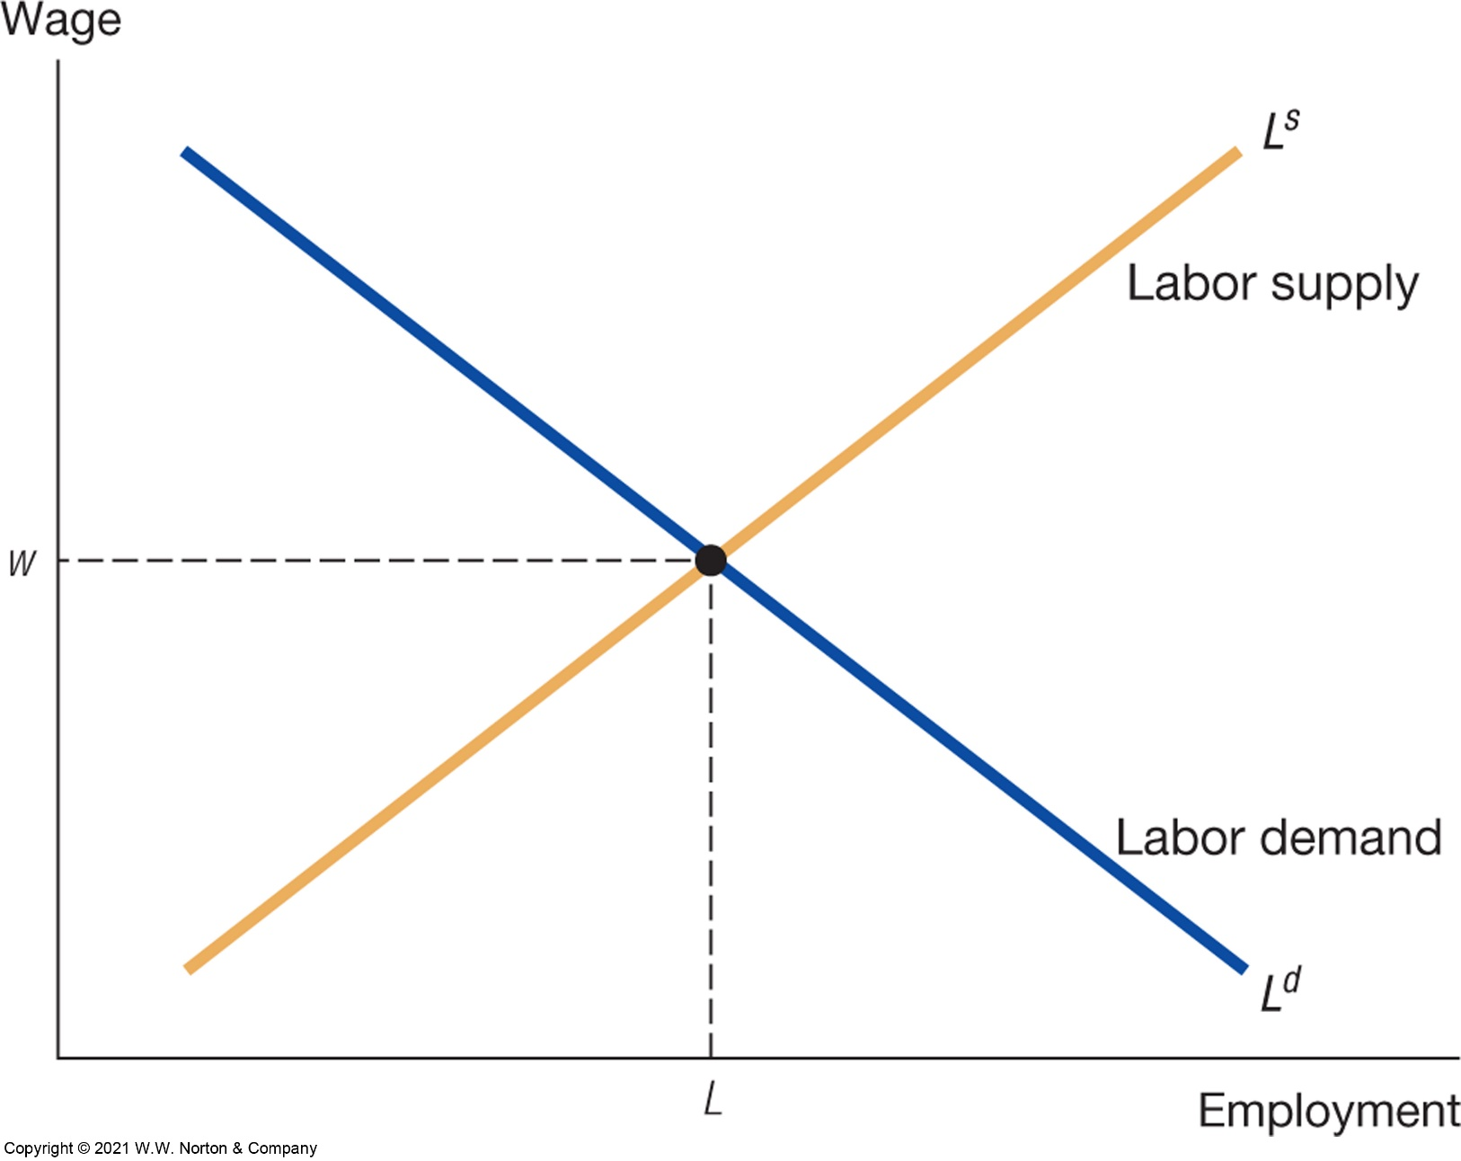
Labor market equilibrium
Source: Jones – Macroeconomics
Notes:
These are contract wages

Slide 34
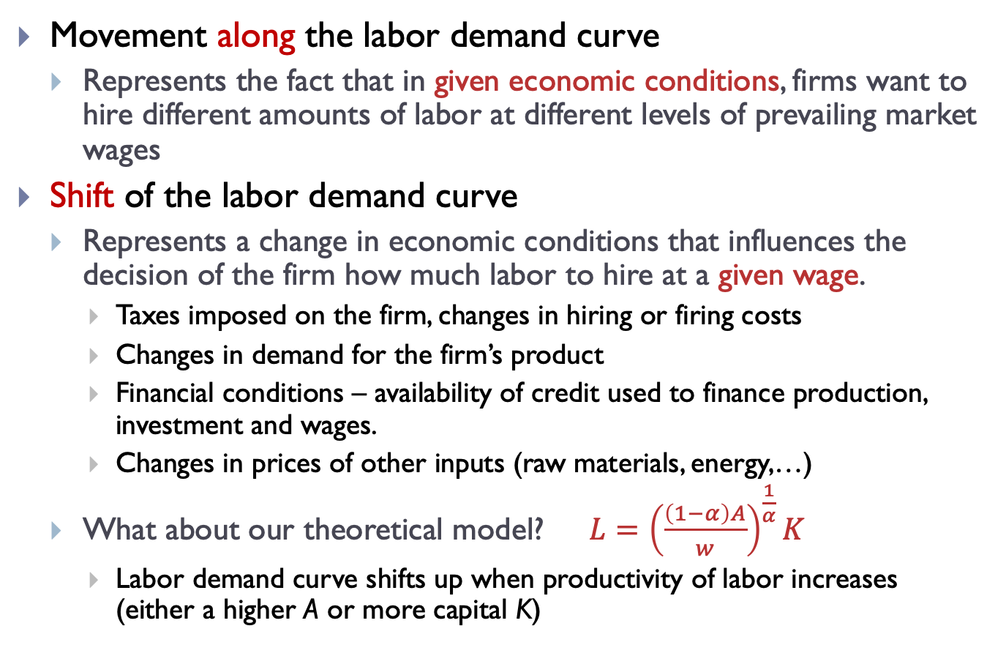
When does the labor demand curve shift?
Movement along the labor demand curve
Represents the fact that in given economic conditions, firms want to hire different amounts of labor at different levels of prevailing market wages
Shift of the labor demand curve
Represents a change in economic conditions that influences the decision of the firm how much labor to hire at a given wage.
Taxes imposed on the firm, changes in hiring or firing costs
Changes in demand for the firm’s product
Financial conditions – availability of credit used to finance production, investment and wages.
Changes in prices of other inputs (raw materials, energy,…)
What about our theoretical model? $L={\left(\frac{\left(1−α\right)A}{w}\right)}^{\frac{1}{α}}K$
Labor demand curve shifts up when productivity of labor increases (either a higher A or more capital K)

Slide 35
When does the labor supply curve shift?
Movement along the labor supply curve
Represents the fact that when wage increases
People want to work more, sacrificing more leisure (intensive margin)
More people join the labor force (extensive margin)
Shift of the labor supply curve
Factors other than wage that determine the willingness of people to work.
Wealth – with more wealth (that is not generated by wages), people would want to work less
Labor taxes imposed on the worker
More valuable leisure?

Slide 36
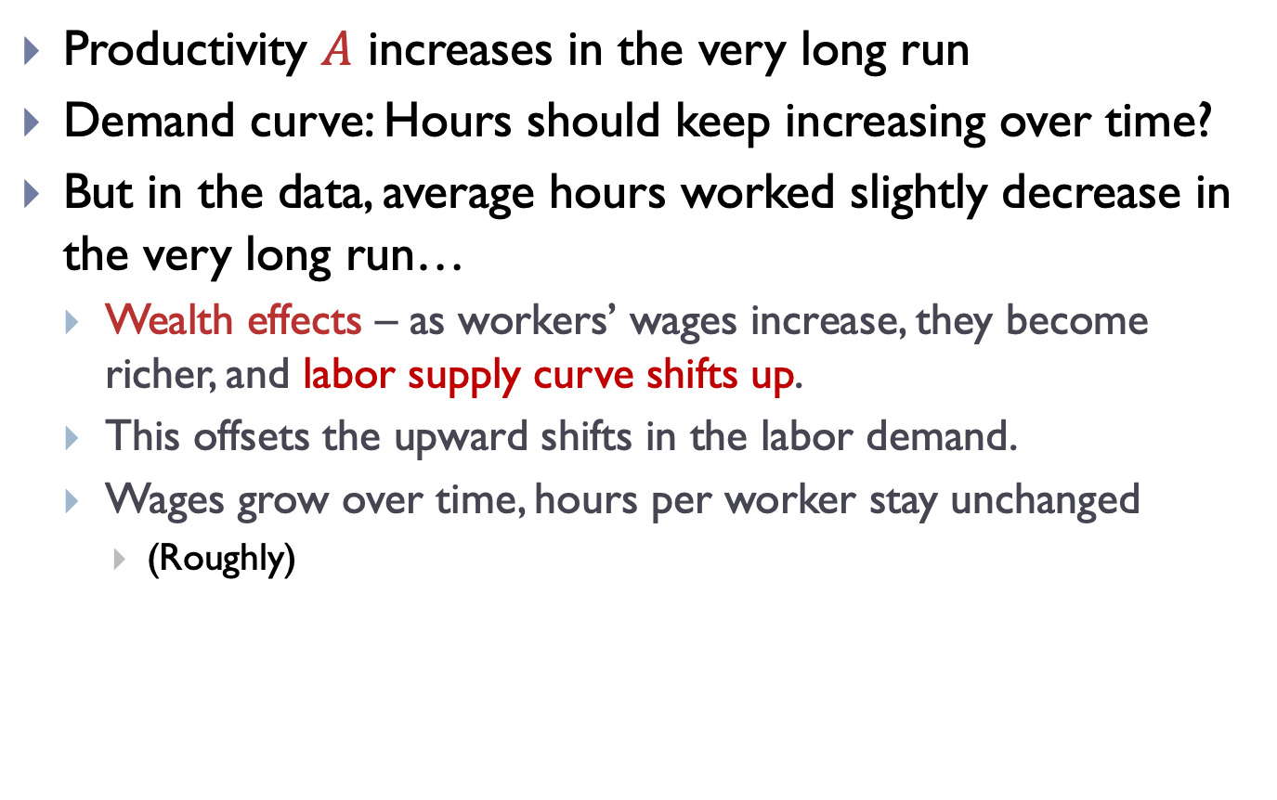
Labor and aggregate productivity
Productivity $A$ increases in the very long run
Demand curve: Hours should keep increasing over time?
But in the data, average hours worked slightly decrease in the very long run…
Wealth effects – as workers’ wages increase, they become richer, and labor supply curve shifts up.
This offsets the upward shifts in the labor demand.
Wages grow over time, hours per worker stay unchanged
(Roughly)

Slide 37
Walrasian labor market: implications
Is it good for the worker that the government imposes a minimum wage?
Is it good for the firm? Can it sustain aggregate demand?
Labor taxation: does it matter, whether the government taxes the firm or the worker?
Is the household better off if the government taxes the firm rather than the worker?

Slide 38
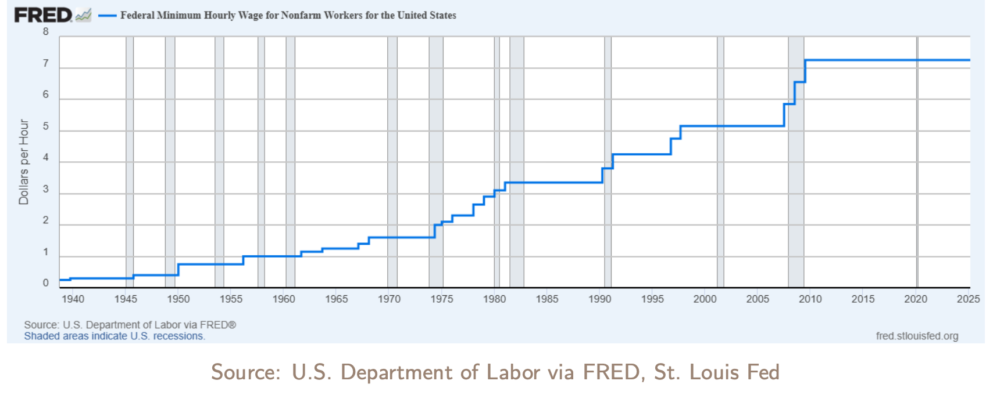
Minimum wage in the United States
Minimum wage in nominal terms in the United States since 1940… has been steadily increasing

Slide 39
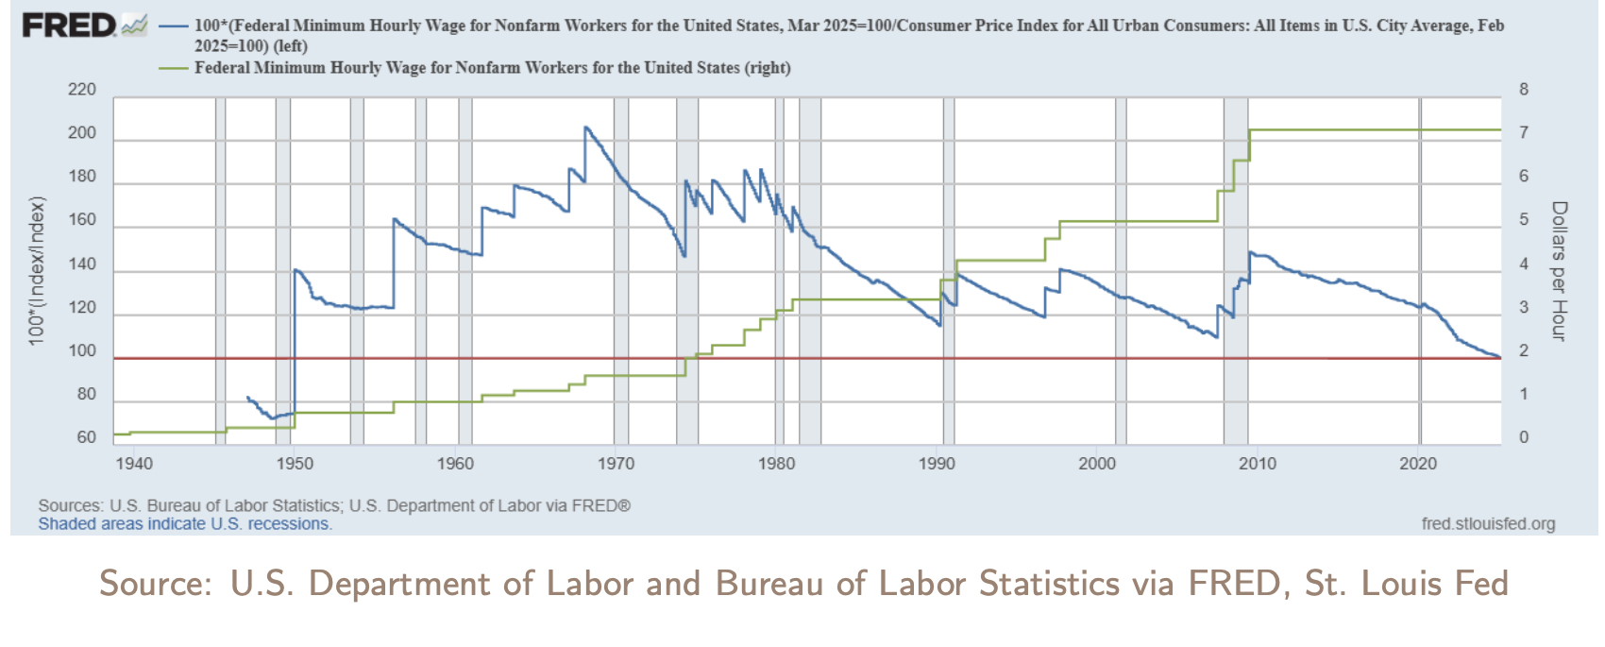
Minimum wage in the United States
Minimum wage in real terms in the United States since 1940… has never been so low

Slide 40
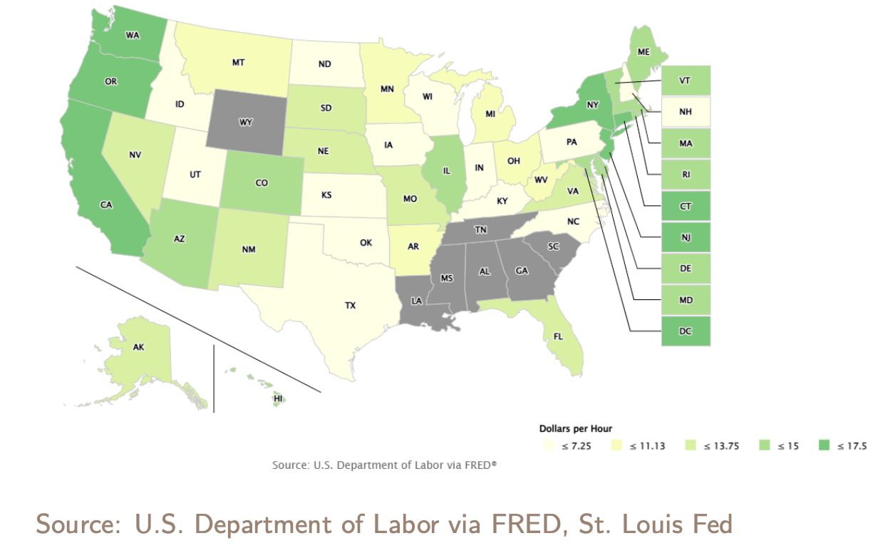
Minimum wage across States
Huge heterogeneity across states

Slide 41
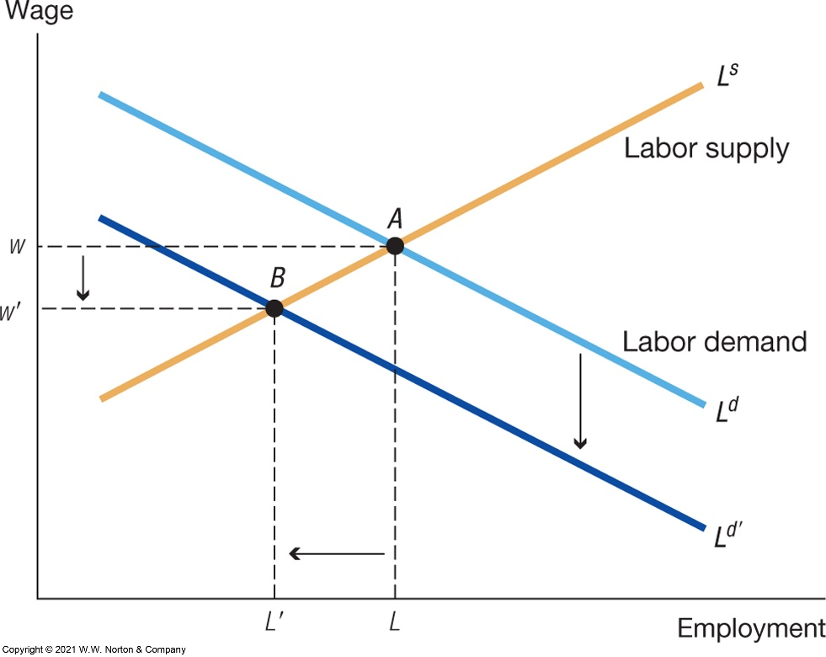
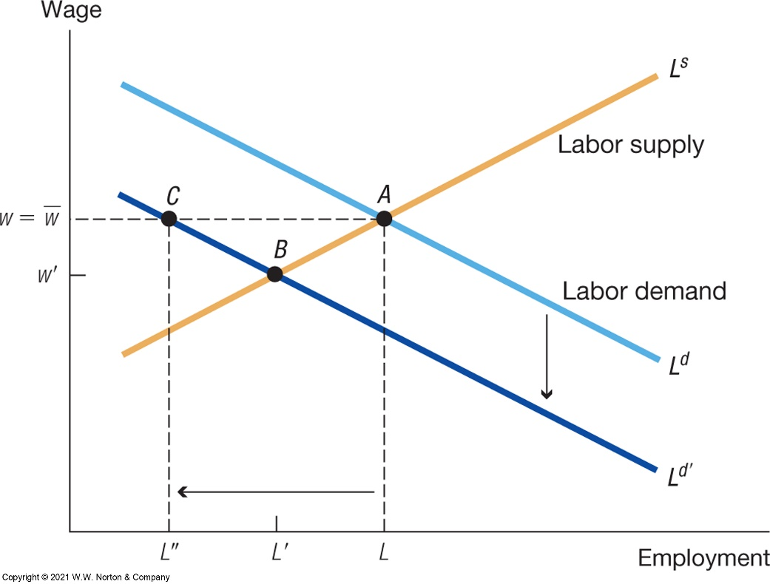
Flexible vs. rigid wages
Our baseline model could not generate involuntary unemployment
Everybody who wanted to work at the market wage had a job
We need another mechanism – rigid wages
Consider the impact of a negative labor demand shock
Flexible wages – wage decreases, no involuntary unemployment
Rigid wages – wage does not decrease, involuntary unemployment (Keynes)
Source: Jones – Macroeconomics

Slide 42
Do minimum wages increase unemployment?
Basic theory says yes but the world is more complex.
Magnitude of the effect depends on context – level of worker skills, level of the minimum wage, state of the economy.
Market imperfections like monopsonies may theoretically overturn the result.
Aggregate demand may overturn the result as well.
What does the empirical literature find?
Most of the literature indeed finds that higher minimum wages lead to higher unemployment.
Some prominent results (Card and Krueger (1994)) find the opposite but they are a minority.
Measurement is complicated by presence of endogeneity.
Dependence on context plays an important role for the magnitude of the effect.

Slide 43
Card and Krueger (1994)
Probably the most famous paper in the literature
Analyze rise of the minimum wage in New Jersey in 1992 from $4.25 to $5.05
New Jersey is the treated state
Control: Pennsylvania, which started at the same minimum wage and did not have increase
Data collected from fast-food establishments

Slide 44
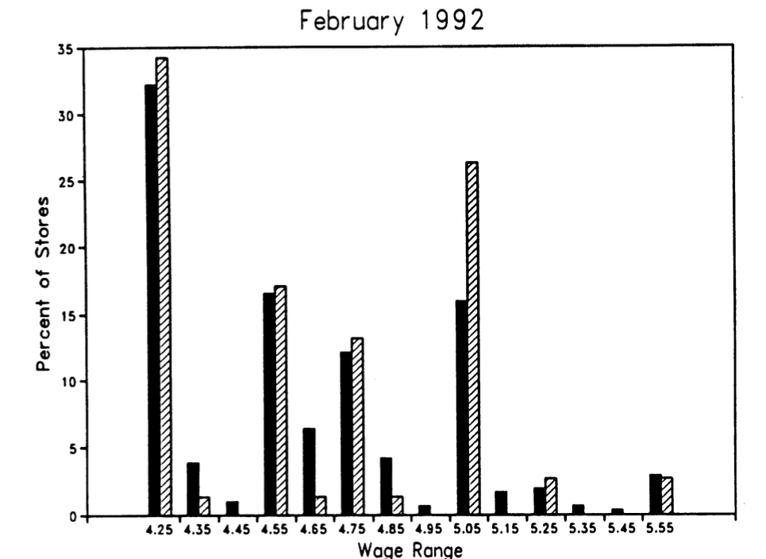
Card and Krueger (1994)
Before the reform, the distribution of wages is quite comparable between NJ and Pennsylvania

Slide 45
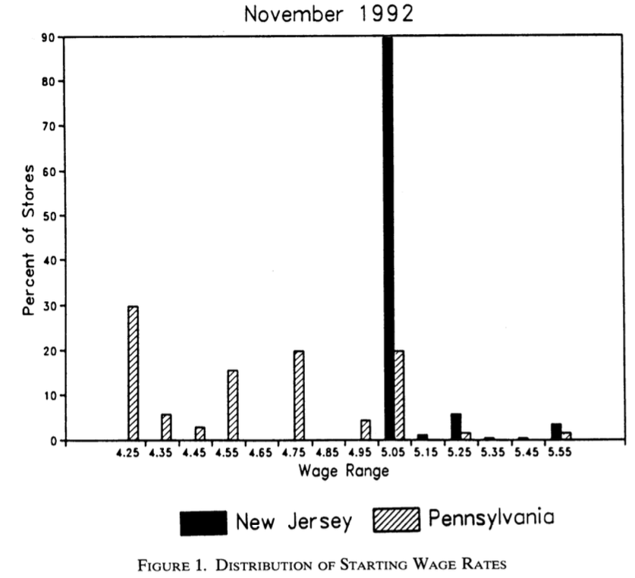
Card and Krueger (1994)
After the reform, the distribution of wages is very different
The reform has some “bite”

Slide 46
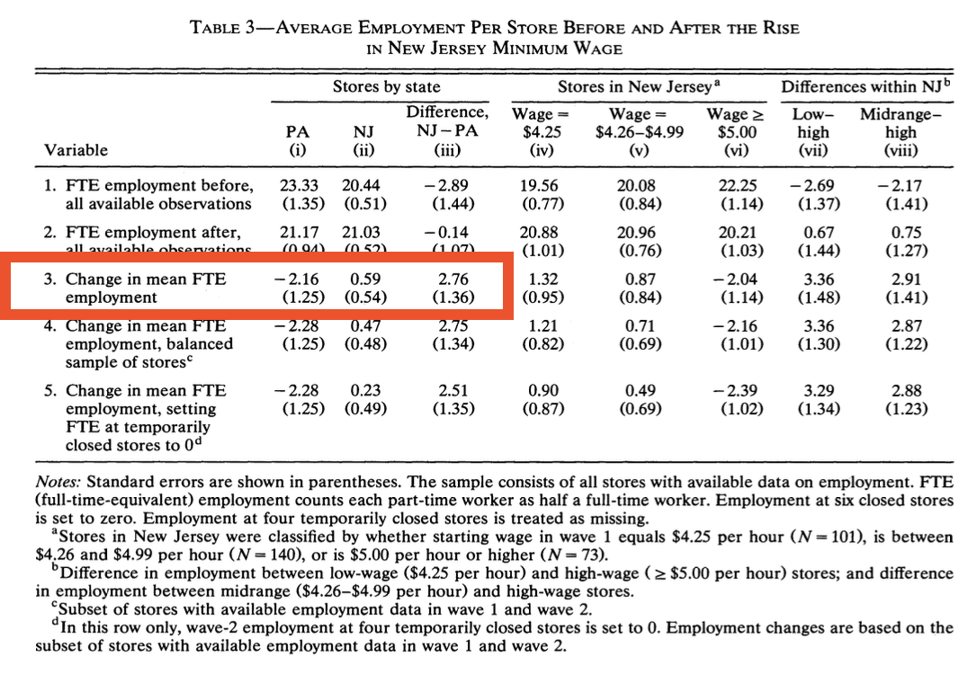
Card and Krueger (1994)

Slide 47
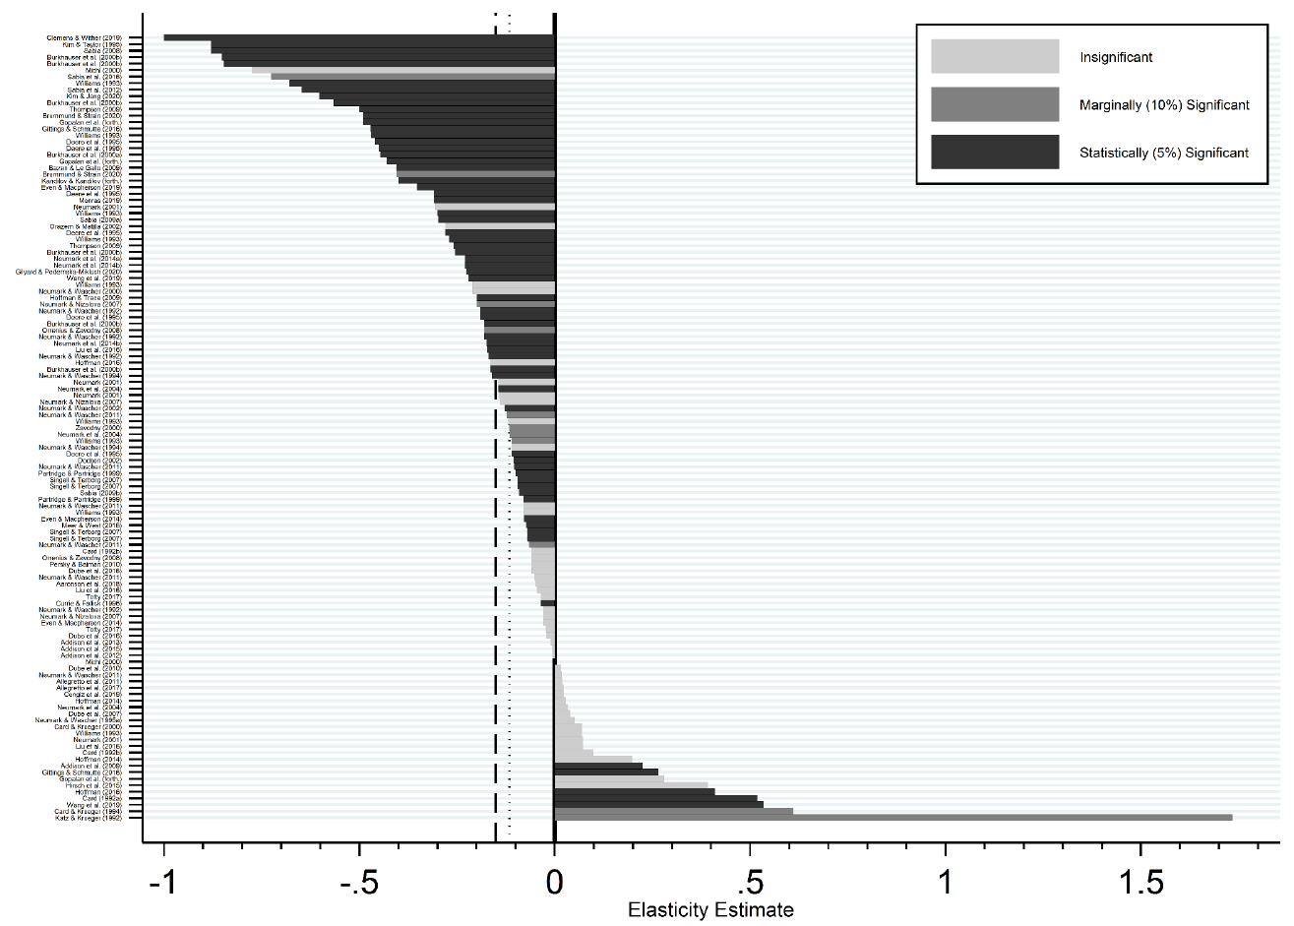
Estimated elasticity of employment to minimum wage
Most of the literature finds negative effects.
Card and Krueger (1994)
Source: Neumark, Shirley (2021)

Slide 48
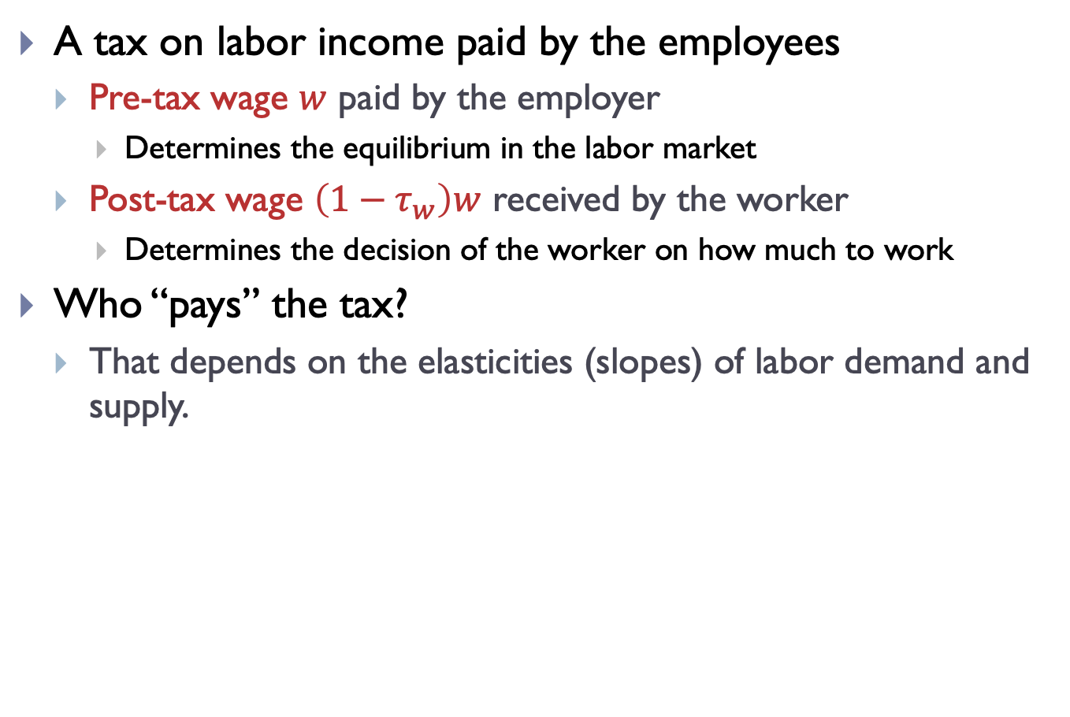
Walrasian labor market and labor taxes
A tax on labor income paid by the employees
Pre-tax wage $w$ paid by the employer
Determines the equilibrium in the labor market
Post-tax wage $\left(1−τ_{w}\right)w$ received by the worker
Determines the decision of the worker on how much to work
Who “pays” the tax?
That depends on the elasticities (slopes) of labor demand and supply.

Slide 49
Labor market equilibrium
Source: Jones – Macroeconomics
Notes:
These are contract wages

Slide 50

Labor market equilibrium
Source: Jones – Macroeconomics
Notes:
These are contract wages

Slide 51
Labor market equilibrium
Source: Jones – Macroeconomics
Notes:
These are contract wages

Slide 52
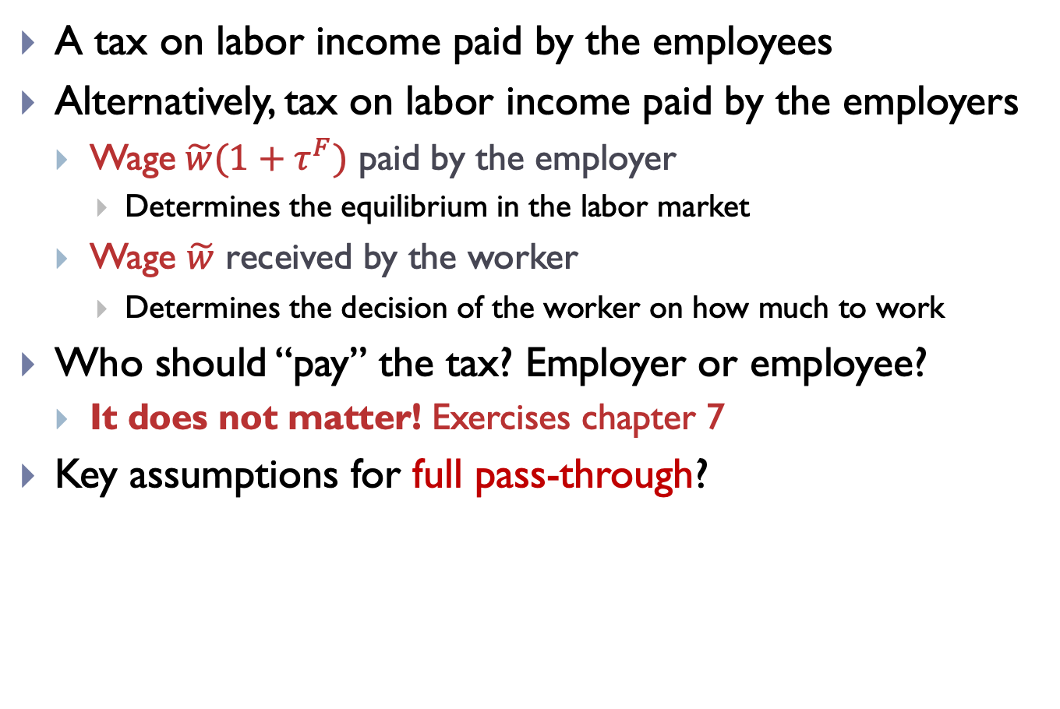
Walrasian labor market and labor taxes
A tax on labor income paid by the employees
Alternatively, tax on labor income paid by the employers
Wage$\tilde{w}(1+τ^{F})$ paid by the employer
Determines the equilibrium in the labor market
Wage $\tilde{w}$ received by the worker
Determines the decision of the worker on how much to work
Who should “pay” the tax? Employer or employee?
It does not matter! Exercises chapter 7
Key assumptions for full pass-through?

Slide 53
Labor market equilibrium
Source: Jones – Macroeconomics
Notes:
These are contract wages

Slide 54
Outline
Labor market evidence from the U.S.
Household maximization problem
Walrasian model of the labor market
Aggregate labor and supply demand
Taxation & minimum wage
Modern models of the labor market
A bathtub model of unemployment
Search and matching theory of the labor market
Labor market flows, unemployed and job vacancies
Beveridge curve

Slide 55
Labor market flows
U.S. labor market is very dynamic
Hiring and firing is relatively easy
Every month, 4-5 million workers lose or leave a job, and about the same amount of workers finds a job
About a third of the labor force switches jobs each year
Change in employment = hires minus separations
Hires – number of newly hired people
Separations – number of people who leave or lose a job
Quits – voluntary from the side of the employee
Layoffs – involuntary from the side of the employee
Other separations (retirement, transfer, …)

Slide 56
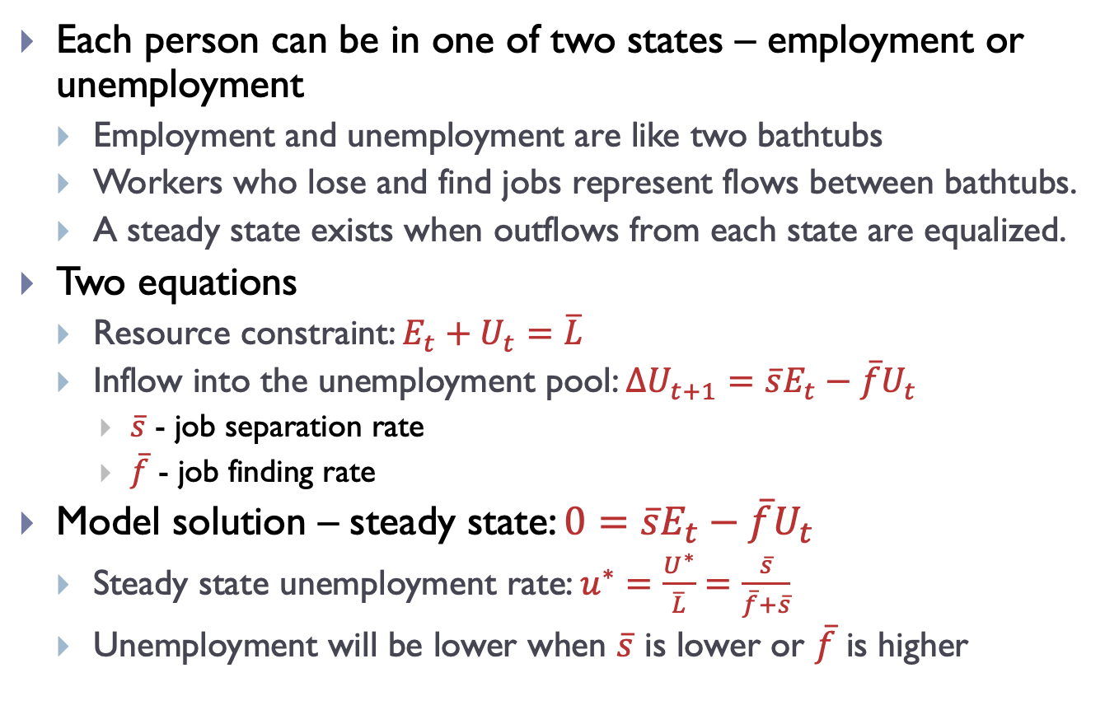
A bathtub model of unemployment
Each person can be in one of two states – employment or unemployment
Employment and unemployment are like two bathtubs
Workers who lose and find jobs represent flows between bathtubs.
A steady state exists when outflows from each state are equalized.
Two equations
Resource constraint: $E_{t}+U_{t}=\overline{L}$
Inflow into the unemployment pool: $∆U_{t+1}=\overline{s}E_{t}−\overline{f}U_{t}$
$\overline{s}$ - job separation rate
$\overline{f}$ - job finding rate
Model solution – steady state: $0=\overline{s}E_{t}−\overline{f}U_{t}$
Steady state unemployment rate: $u^{∗}=\frac{U^{∗}}{\overline{L}}=\frac{\overline{s}}{\overline{f}+\overline{s}}$
Unemployment will be lower when $\overline{s}$ is lower or $\overline{f}$ is higher

Slide 57

Rates $\overline{s}$ and $\overline{f}$in the U.S. across workers
We first talk about numbers “in steady state”, that is, averaging across recessions and expansions
“In general”, for whom is the risk of losing their job higher? The low-wage or the high-wage?
Clearly, the low-wage
Job separation rate is higher for lower wages
After falling into unemployment, for whom is the duration of unemployment the longer? The [previously] low-wage or the [previously] high-wage?
Duration is roughly constant in the distribution!
Job finding rate is constant in the distribution

Slide 58

Rates $\overline{s}$ and $\overline{f}$in the U.S. in the cycle
Now, in recessions, when aggregate unemployment increases
Duration increases (a lot) and the risk of losing their job increases (a bit)
Duration increases more for the low- or high-wage workers?
Duration increases for all workers in a homogenous way!
What about job separation rates?
Higher elasticity of job separation rates to aggregate unemployment for high-wage workers!
That is: % change in s after a 1% change in U [%, not absolute]
“Separations, Sorting, and Cyclical Unemployment,” A. Mueller, American Economic Review (2017)

Slide 59
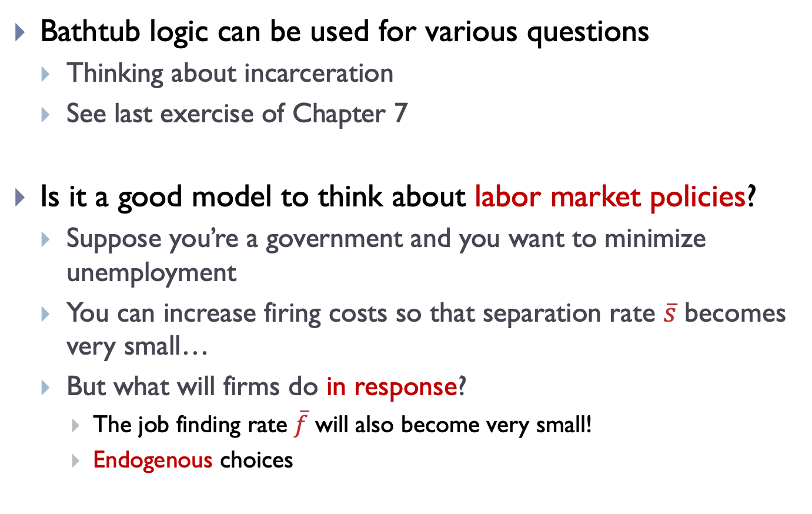
A bathtub model of unemployment
Bathtub logic can be used for various questions
Thinking about incarceration
See last exercise of Chapter 7
Is it a good model to think about labor market policies?
Suppose you’re a government and you want to minimize unemployment
You can increase firing costs so that separation rate $\overline{s}$ becomes very small…
But what will firms do in response?
The job finding rate $\overline{f}$ will also become very small!
Endogenous choices

Slide 60
Search and matching models
Modern models of unemployment are based on the idea that searching for a job takes time (search friction)
Search and matching models of unemployment
Nobel Prize 2010: Diamond, Mortensen, Pissarides
Two critical variables
Number of job searchers – unemployed searching for a job, endogenous
Number of vacancies – available job openings, endogenous
Economic bad times (recession)
Few vacancies, many job searchers competing for the few vacancies ⇒ hard to find a job, long duration of unemployment
Economic good times (expansion)
Many vacancies, few competing job searchers ⇒ easy to find a job, short duration of unemployment
Beveridge curve – the systematic relationship between the vacancy rate and the unemployment rate
Vacancy rate: # vacancies / employment
What do shifts in the Beveridge curve indicate? (see graph)

Slide 61
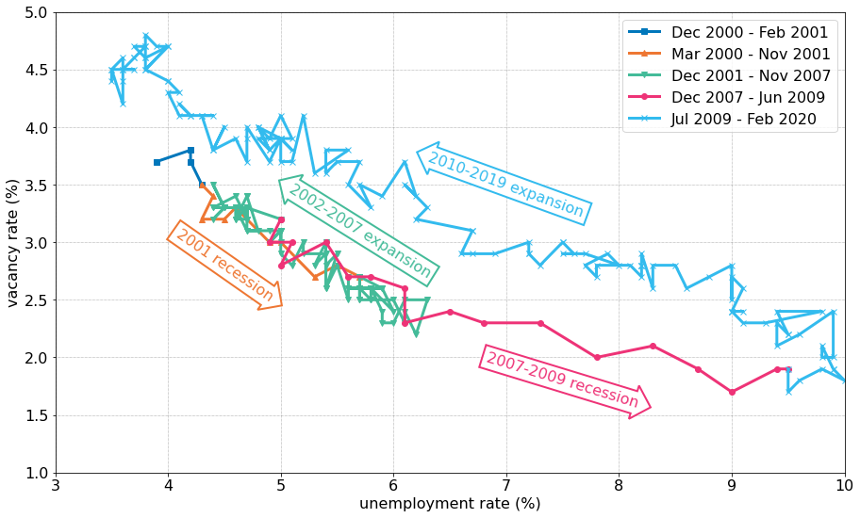
Beveridge curve
Source: FRED (series UNRATE and JTSJOR – monthly data)
Notes:
CUT OUT SLIDE: Minimum wage
In the model of labor supply and demand a minimum wage works like wage rigidity
Minimum wage higher than equilibrium wage – involuntary unemployment
So why do we institute a minimum wage?
Cochrane’s blog
It’s like a rigid wage

Slide 62
Review questions
What are the stylized facts in the U.S. (and in other countries, as discussed) for
Unemployment and employment
Job market flows
What is a Walrasian model of the labor market?
Why did we construct the bathtub model of unemployment?
Why can’t the Walrasian model with flexible wages explain involuntary unemployment? What is a remedy we used?
Read: Jones, Chapter 7

